Slide 1
Embedding Power BI Reports using SPFX
Notes:
This module provides students with a quick Primer on Power BI and introduces students to the Power BI Service API. The module also provides an overview of the Power BI features for embedding reports and dashboards into custom applications. Students will learn how to call the Power BI Service API from an SPFX Web Part using the AadHttpClient class. The module explains how to use the Power BI Service API to retrieve the data required for embedding reports and dashboard. The module explains how to install and use the Power BI JavaScript API to write the client-side code required to embed Power BI reports and dashboards inside an SPFX Web Part. Along the way, students will also learn how to add custom Web Part properties to provide users with the ability to customize the way that reports and dashboards appear when embedded on a page in a SharePoint site.

Slide 2
Agenda
Power BI Embedding Fundamentals
App Workspaces and Dedicated Capacities
Programming with Power BI Service API
Embedding with Power BI JavaScript API
Calling the Power BI Service using AadHttpClient

Slide 3
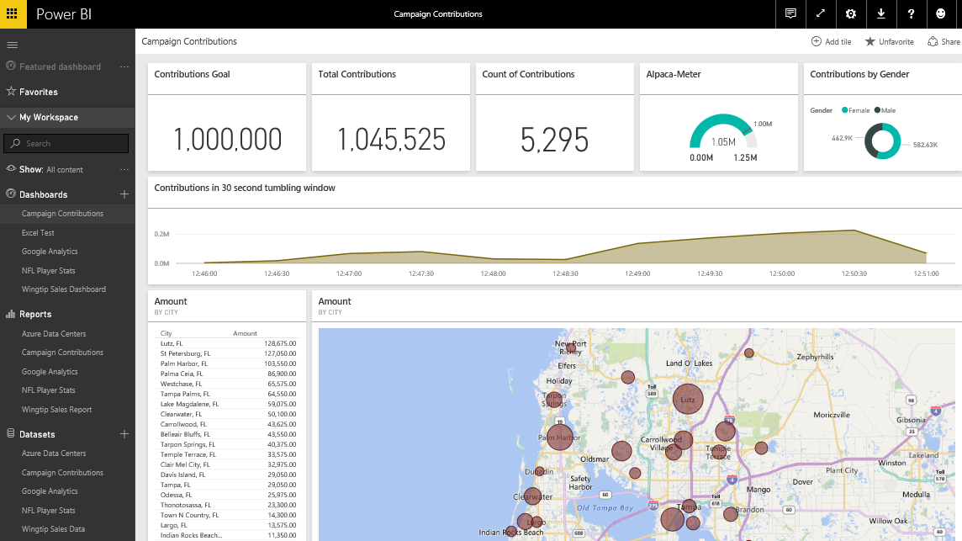
The Power BI Service
Provides cloud-based foundation for Power BI platform
Accessible with browser through https://app.powerbi.com
Accessible through Power BI mobile apps
Accessible to developers through Power BI Service API
Notes:
You can think of the Power BI service as the heart and sole of the Power BI platform. Subscribed users access the Power BI service using any modern browser through its primary URL which is https://app.powerbi.com. Once a user has been authenticated against the common endpoint of https://app.powerbi.com, the users is then connected to the Azure data center which hosts the user’s Power BI workspaces.
Using the browser, a Power BI subscriber can view dashboard and interactive reports. The browser-based experience of the Power BI service also provides support to import datasets and to create reports and dashboards.

Slide 4
The Power BI Service API
The Power BI Service API goes by other names
The Power BI REST API
The Power BI API
Using the Power BI Service API
Accessible by making direct REST calls against service
Accessible by using Assembly DLL that abstracts away REST calls
Assembly DLL is named Microsoft.PowerBI.Api.dll
Assembly DLL part of NuGet package (Microsoft.PowerBI.Api)
Calling service requires authentication with Azure Active Directory
Your App
Power BI Service

Slide 5
Power BI Embedding – The Big Picture
User launches your app using a browser
App authenticates with Azure Active Directory and obtains access token
App uses access token to call to Power BI Service API
App retrieves data for embedded resource and passes it to browser.
Client-side code uses Power BI JavaScript API to create embedded resource
Embedded resource session created between browser and Power BI service
5
Power BI Service
User
iFrame
6
4
4
3
1
Your App
2
Azure AD

Slide 6
First Party Embedding
App authenticates current user with Azure AD
Your code accesses Power BI Service as current user
Embedding requires Azure AD access token for user
User requires Azure AD account and Power BI license
Your code has access to whatever user has access to
Embed URL for Power BI resource
Access Token for current user
User
Power BI Service
iFrame

Slide 7
Third Party Embedding
App authenticates using Master User Account
Your code accesses Power BI Service as master user
Embedding uses embed token instead of access token
Users don’t need AAD accounts and Power BI licenses
Your code has access to whatever master has access to
Embed URL for Power BI resource
Embed Token created with master user account
User
Power BI Service
iFrame

Slide 8
First Party vs Third Party Embedding
What scenarios use first party embedding?
Organizations where users have Power BI licenses
Embedding Power BI reports in SharePoint and Teams
Development should go beyond out-of-box experience
What scenarios use third party embedding?
Scenarios where users don’t have Power BI licenses
Applications which have custom identity providers
Applications which use identity provider other than AAD

Slide 9
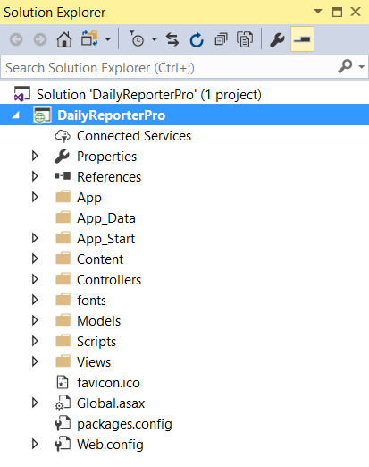
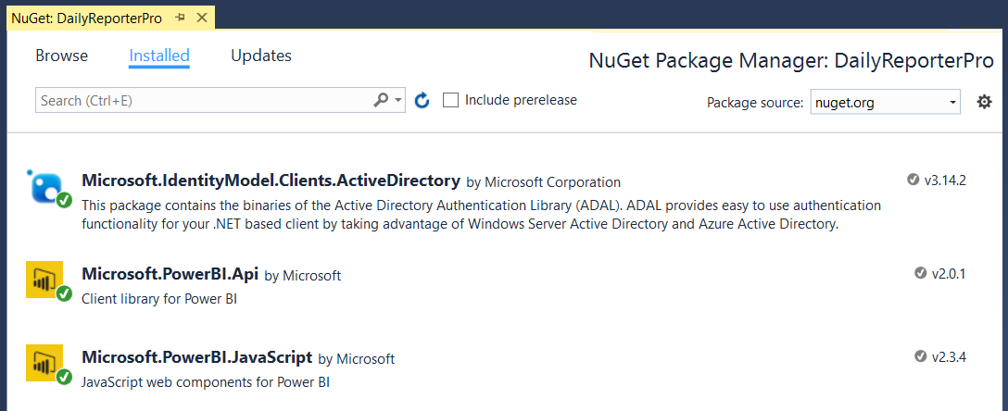
NuGet Packages Required in MVC Project
NuGet Packages used in DailyReporterPro sample app
Azure Active Directory Library (ADAL) for .NET
Power BI Service API
Power BI JavaScript API

Slide 10
The Daily Reporter Pro Sample App

Slide 11
Agenda
Power BI Embedding Fundamentals
App Workspaces and Dedicated Capacities
Programming with Power BI Service API
Embedding with Power BI JavaScript API
Calling the Power BI Service using AadHttpClient

Slide 12
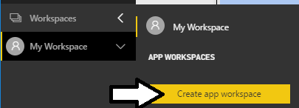
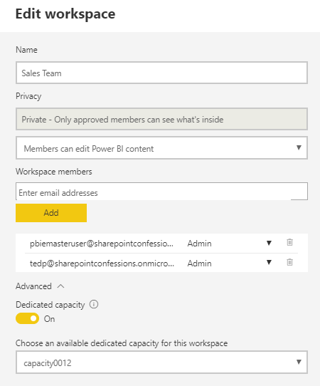
Understanding App Workspaces
App workspaces required for 3rd party embedding
You access working under identity of master user account
Master user account must be configured as app workspace admin
App workspace must be associated with dedicated capacity
Master User Account
Dedicated Capacity

Slide 13
Dedicated Capacities
Power BI workspaces run in two possible environments
Shared capacities
Dedicated capacities
Dedicated capacity required for third party embedding
Customer pays capacity-based fee for processors cores and RAM
No need to pay Microsoft for user licenses
Dedicated capacities come in two flavors
Power BI Premium capacities purchased through Office 365 SKU
Power BI Embedded capacities purchased through Azure SKU

Slide 14
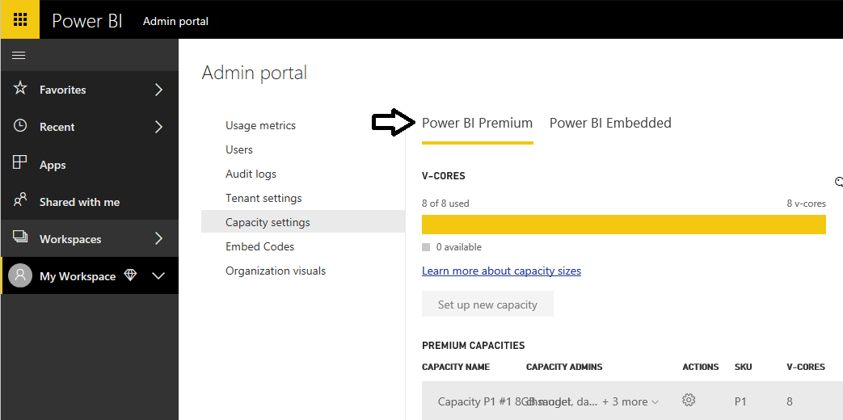
Managing Power BI Premium Capacities

Slide 15
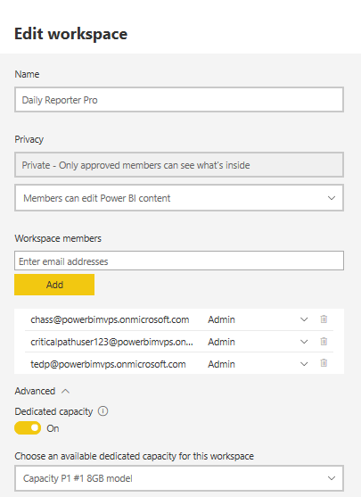
Associating Workspaces with Capacities

Slide 16
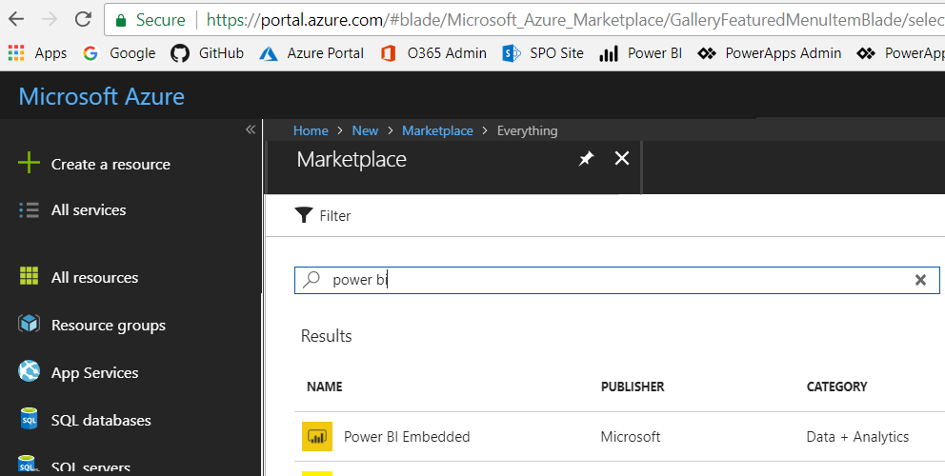
Creating the Power BI Embedded Service
Power BI Embedded in an Azure on-demand service
Can be created manually through the Azure portal
Can be created in automated fashion using PowerShell
Requires an Azure subscription

Slide 17
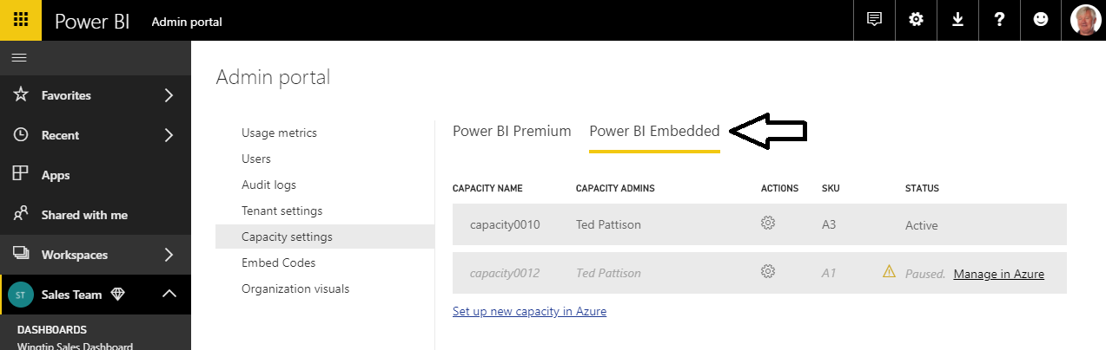
Managing Power BI Embedded Capacities

Slide 18
PBI Capacity SKU Decoder Ring
 | P SKU | EM SKU | A SKU
Purchased through… | Office 365 | Office 365 | Azure
Embed content in custom application | Yes | Yes | Yes
Share content with free PBI users outside PowerBI.com | Yes | Yes | No
Share content with free PBI users inside PowerBI.com | Yes | No | No
Billing | Monthly | Monthly | Hourly
Commitment | Monthly | Monthly/Yearly | None
Turn it off when your not using it | No | No | Yes

Slide 19
1st Party Embedding vs 3rd Party Embedding
 | 1st Part Embedding | 3rd Party Embedding
Authentication flow | Authentication Code Grant Flow or Implicit Flow | Direct User Credentials
Identity used to call Power BI | Current User | Master User Account
Access to personal workspace | Yes | No
Access to app workspaces | Yes | Yes
Ability to reach non-licensed users | No | Yes
Supported Power BI Capacity SKUs | P* and EM* SKUs | P*, EM* and A* SKUs

Slide 20
Agenda
Power BI Embedding Fundamentals
App Workspaces and Dedicated Capacities
Programming with Power BI Service API
Embedding with Power BI JavaScript API
Calling the Power BI Service using AadHttpClient

Slide 21
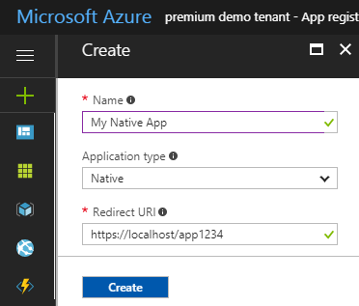
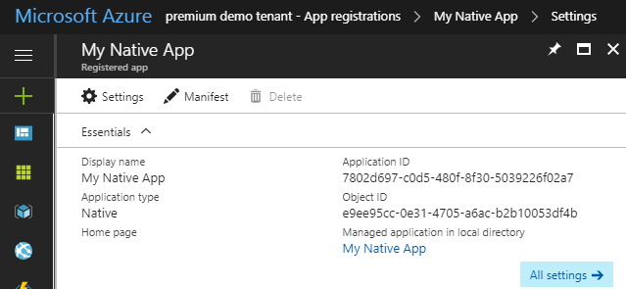
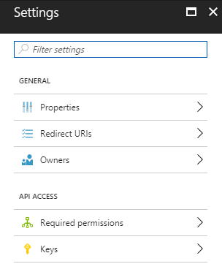
Creating an Azure AD Application

Slide 22
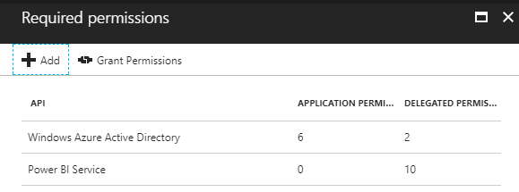
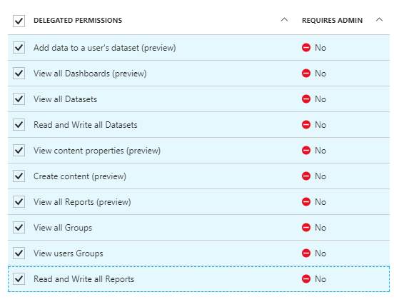
Application Permissions
Applications can be granted permissions to other applications
Application permissions are app-only permissions
Delegated permissions are (app + user) permissions
Delegated permissions requires 1-time consent from user

Slide 23
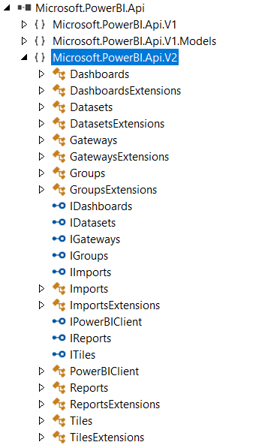
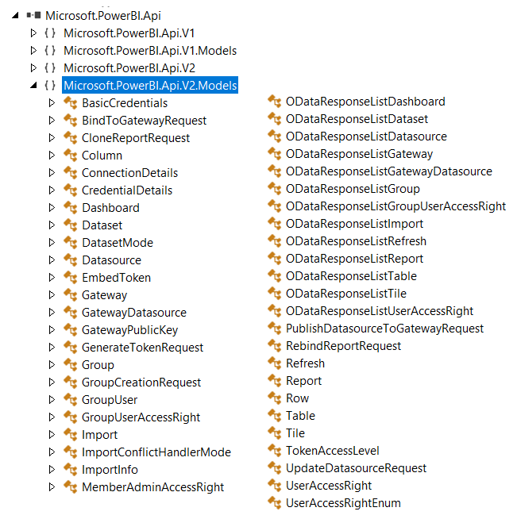
The Power BI Service API

Slide 24
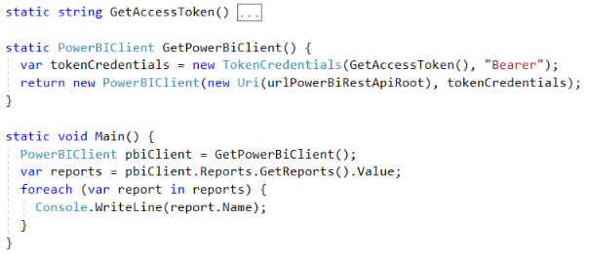
Initializing an Instance of PowerBIClient
PowerBIClient object serves as top-level object
Used to execute calls against Power BI Service
Initialized with function to retrieve AAD access token

Slide 25
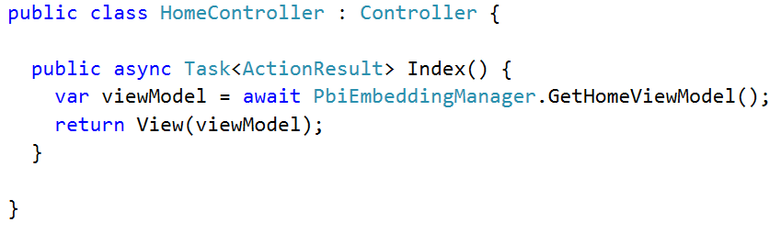
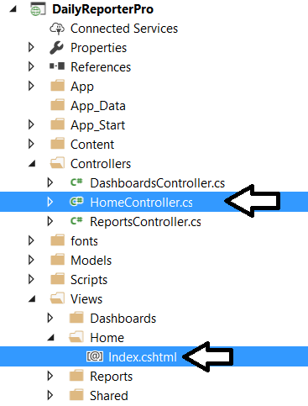
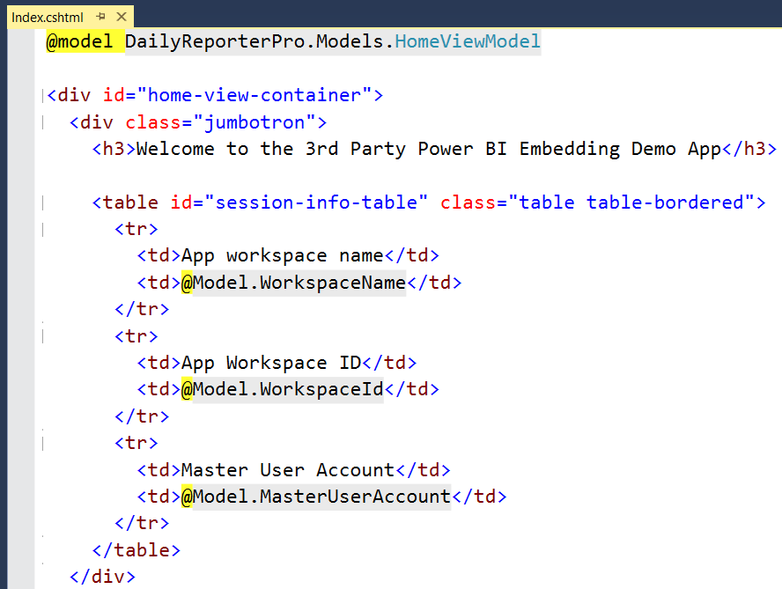
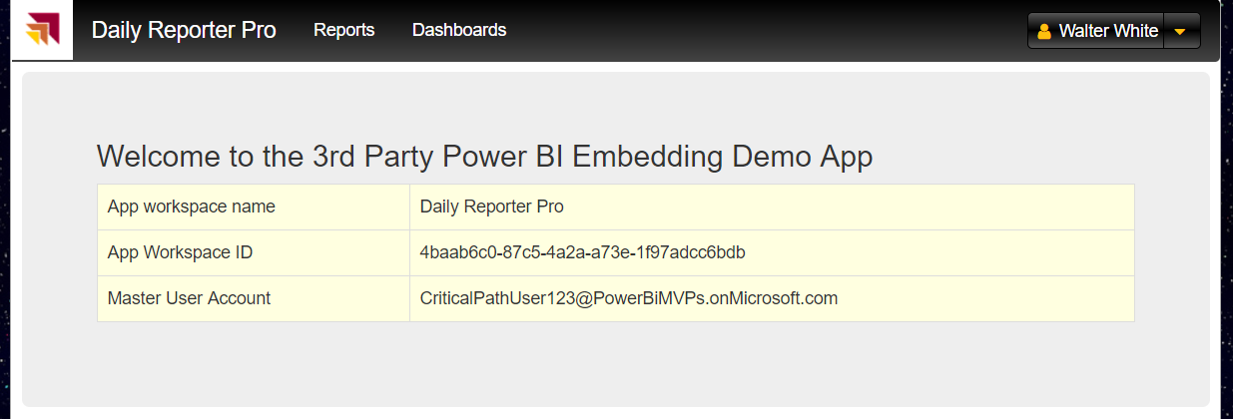
MVC Controllers and Views

Slide 26
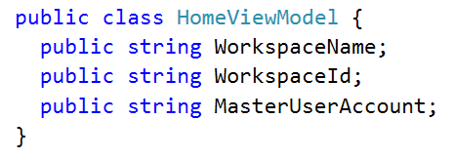
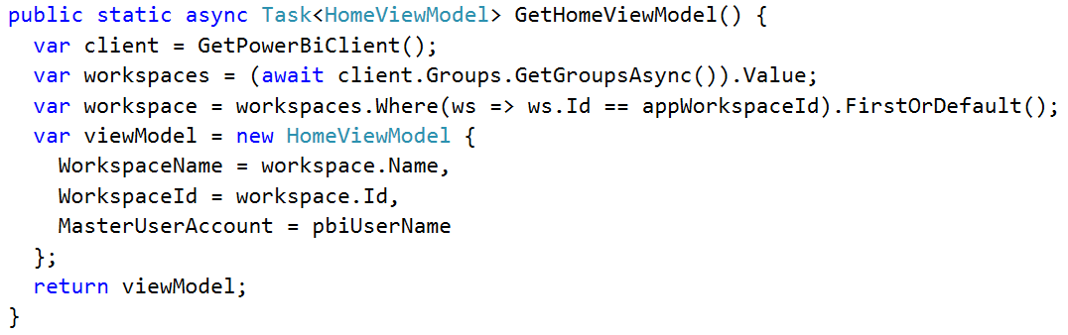
Back to the DailyReporterPro Application
Your App
Power BI Service

Slide 27
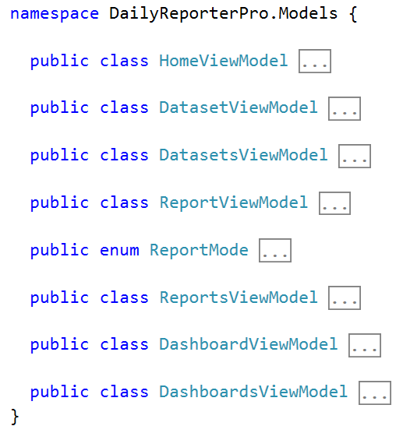
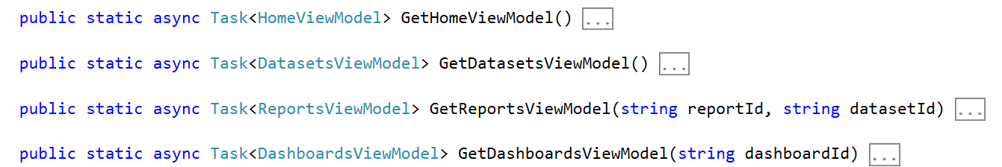
MVC View Models

Slide 28
Agenda
Power BI Embedding Fundamentals
App Workspaces and Dedicated Capacities
Programming with Power BI Service API
Embedding with Power BI JavaScript API
Calling the Power BI Service using AadHttpClient

Slide 29
Embeddable Resources
Reports
Dashboards
Dashboard Tiles
Q & A Experience
Visual *
* really just a trick you do when embedding a report

Slide 30
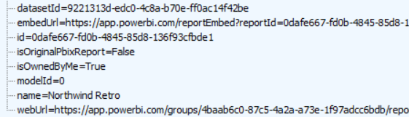
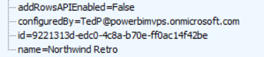
Report and Dataset Info
Embed data required for an existing report
Embed data for dataset required to create new report

Slide 31
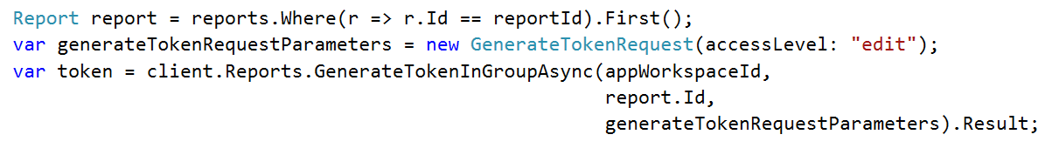
Embed Tokens
You can embed reports using master user AAD token, but…
You might want embed resource using more restricted tokens
You might want stay within the bounds of Power BI licensing terms
Power BI service supports generating embed tokens
Embed token provides restrictions on whether user can view or edit
Each embed token created for one specific resource
Embed token can only be generated inside Power BI Premium capacity
Supports generating tokens using row-level security (RLS)

Slide 32
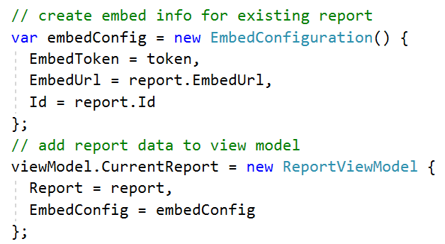
View Model with Embed Data for Report

Slide 33
Agenda
Power BI Embedding Fundamentals
App Workspaces and Dedicated Capacities
Authentication with Azure Active Directory
Programming with Power BI Service API
Working with Embeddable Resources
Embedding with Power BI JavaScript API

Slide 34
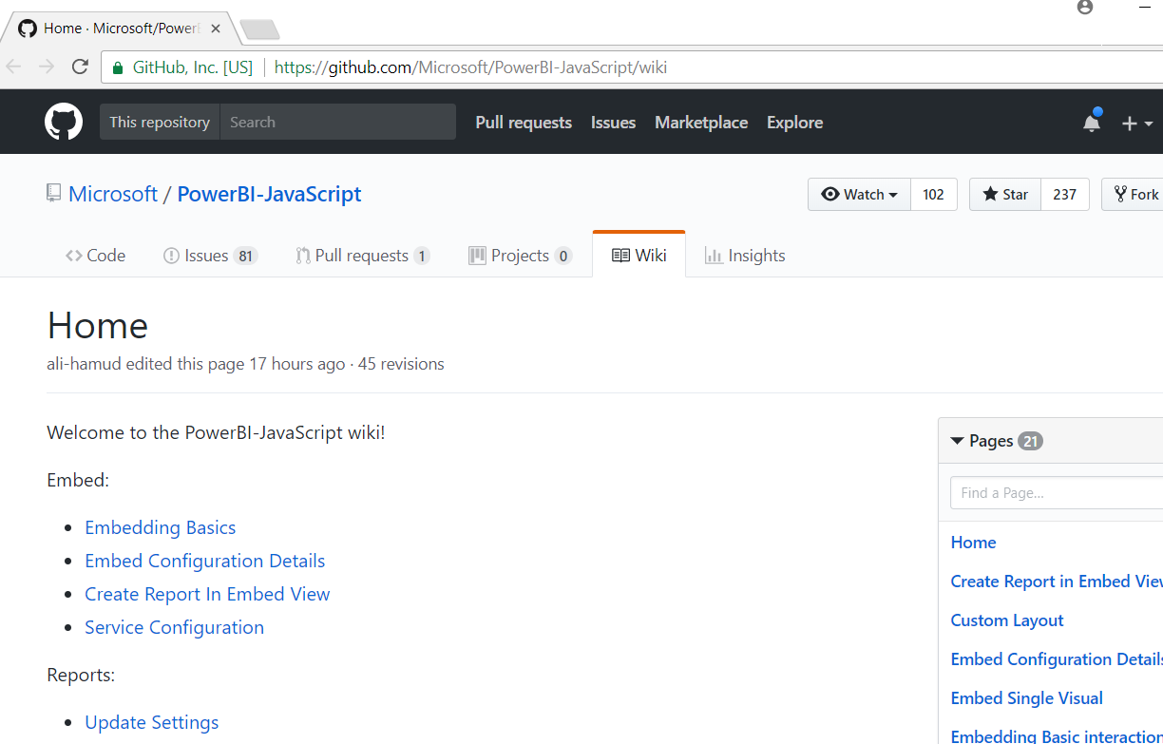
Power BI JavaScript API (PBIJS)
https://github.com/Microsoft/PowerBI-JavaScript/wiki

Slide 35
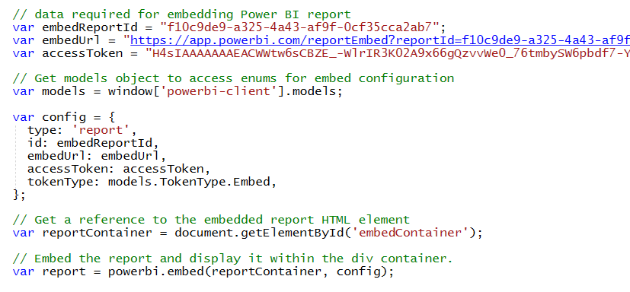
Hello World with Power BI Embedding
PBIJS library provides powerbi as top-level service object
You create configuration and then call powerbi.embed to embed a report
You must pass access token as part of the configuration

Slide 36
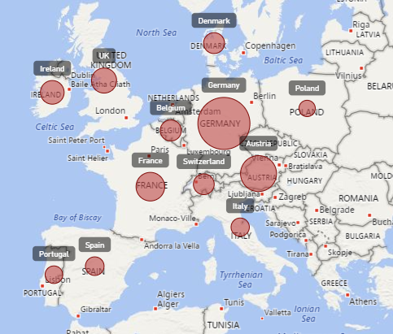
Report Embedding Architecture
Embedding involves creating an iFrame on the page
PBIJS transparently creates iFrame and sets source to Power BI Service
The iFrame and hosting page originate from different DNS domains
Your HTML and CSS
https://app1.mydomain.com
Web Hosting Server
Your
JavaScript
iFrame
Embedding Data
https://wabi-us-east2-redirect.analysis.windows.net/
powerbi.js
Power BI Service

Slide 37
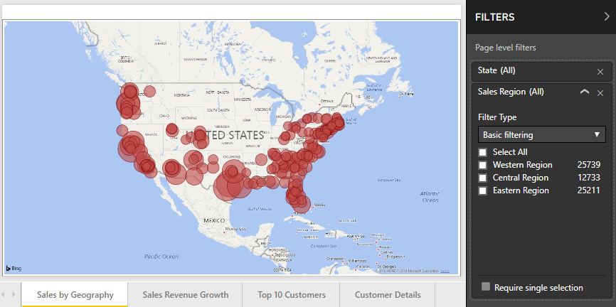
Post Message Communications Flow
4 extra libraries used communicate with report in iFrame
window-post-message-proxy (WPMP)
http-post-message (HPM)
powerbi-router (PBIR)
powerbi-models (PBIM)
iFrame
Your
JavaScript
service
report
HPM
PBIR
WPMP
WPMP
PBIR
HPM

Slide 38
A Promise-based Programming Model
Design of PBIJS simulates HTTP protocol
Creates more intuitive programming model for developers
Programming based on asynchronous requests and promises
Embedded objects programmed using actions and events
Actions
report.fullscreen
report
report.switchMode
report.setFilters
Your
JavaScript
report.getPages
Events
report.loaded
report.pageChanged
report.commandTriggered

Slide 39
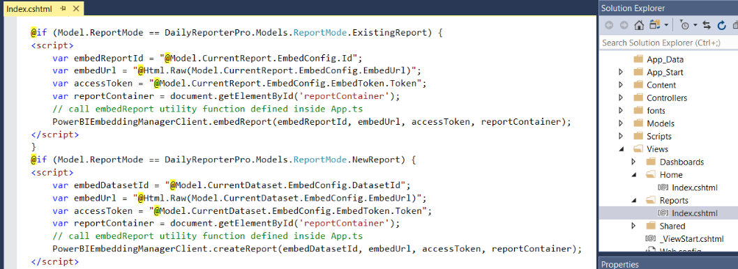
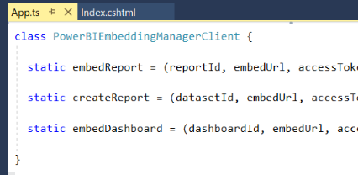
Embedding Data in MVC View

Slide 40
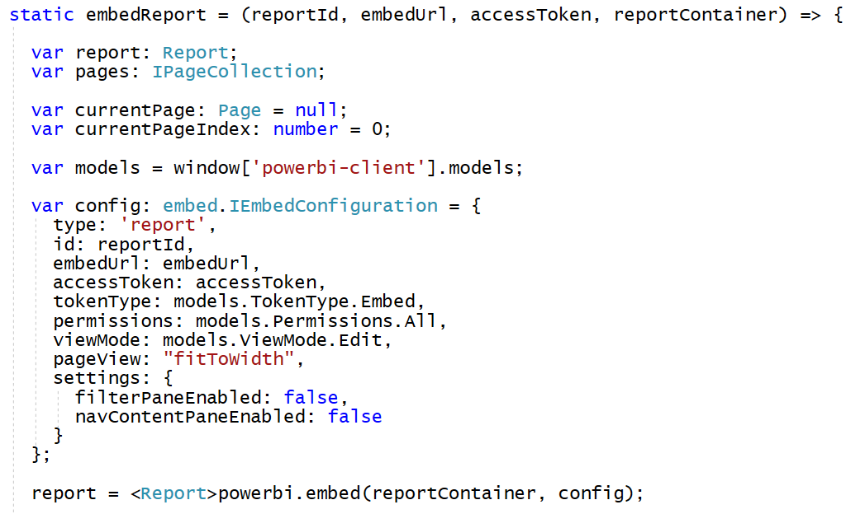
Loading an Embedded Report

Slide 41
Embedded Report Options
Read: Allows view report only.
ReadWrite: Allows view, Edit and Save report.
Copy: Allows Save a copy of a report using Save As.
Create: Allows creating a new report.
All: Allows everything.
View - Opens report in View mode.
Edit - Opens report in Edit mode.
fitToWidth: Fit to width of host HTML element.
oneColumn: Opens in single column.
actualSize: Actual size as designed in report

Slide 42
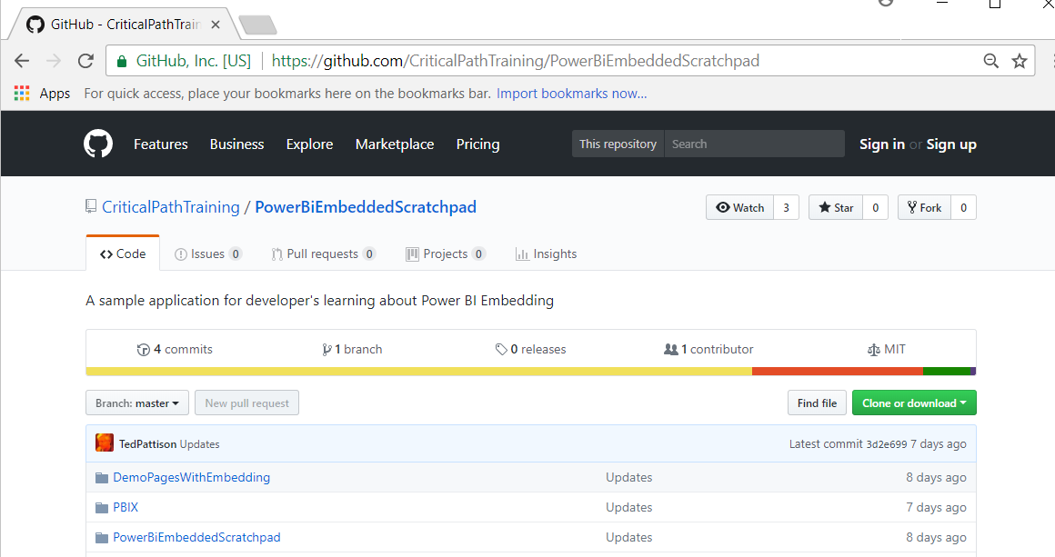
PowerBiEmbeddedScratchpad Sample
https://github.com/CriticalPathTraining/PowerBiEmbeddedScratchpad

Slide 43
The Power BI Embedded Scratchpad App

Slide 44
Agenda
Power BI Embedding Fundamentals
App Workspaces and Dedicated Capacities
Programming with Power BI Service API
Embedding with Power BI JavaScript API
Calling the Power BI Service using AadHttpClient

Slide 45
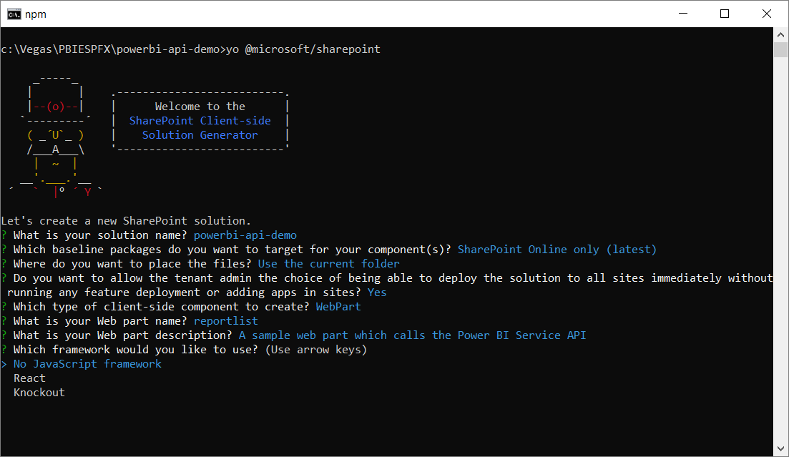
Create a New SPFX Web Part Project

Slide 46
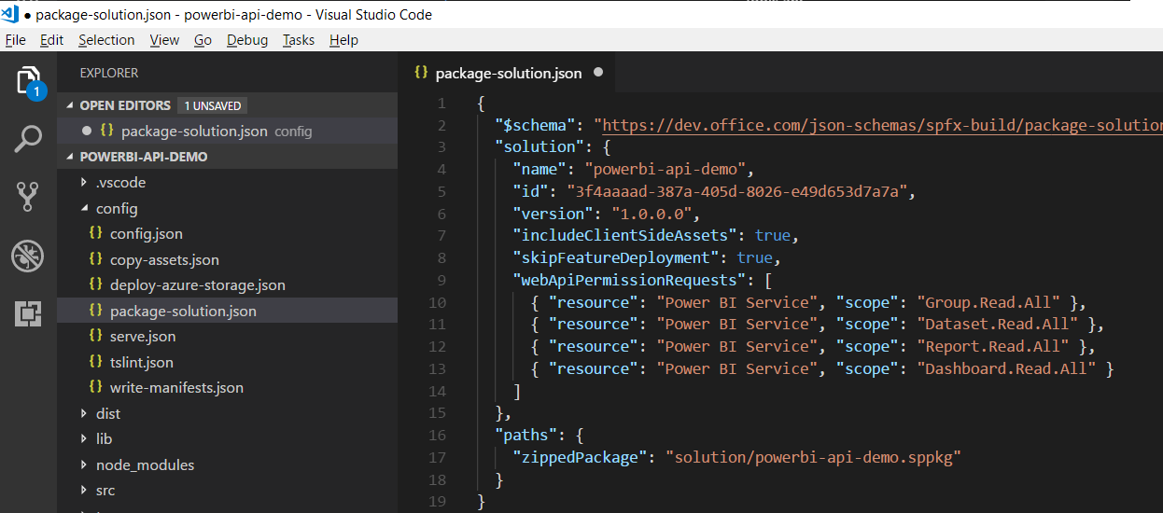
Configuring Web API Permissions

Slide 47
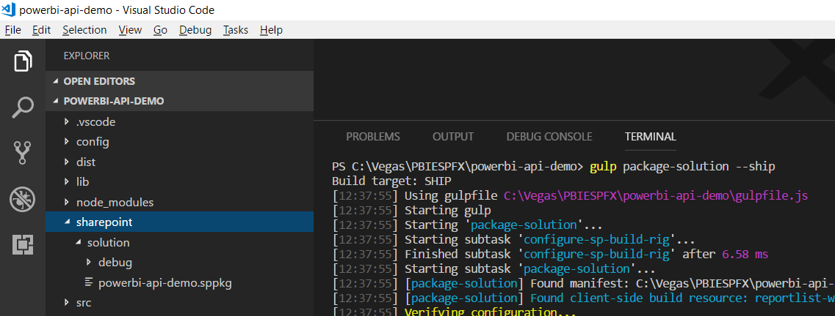
Packaging Your SPFX Solution

Slide 48
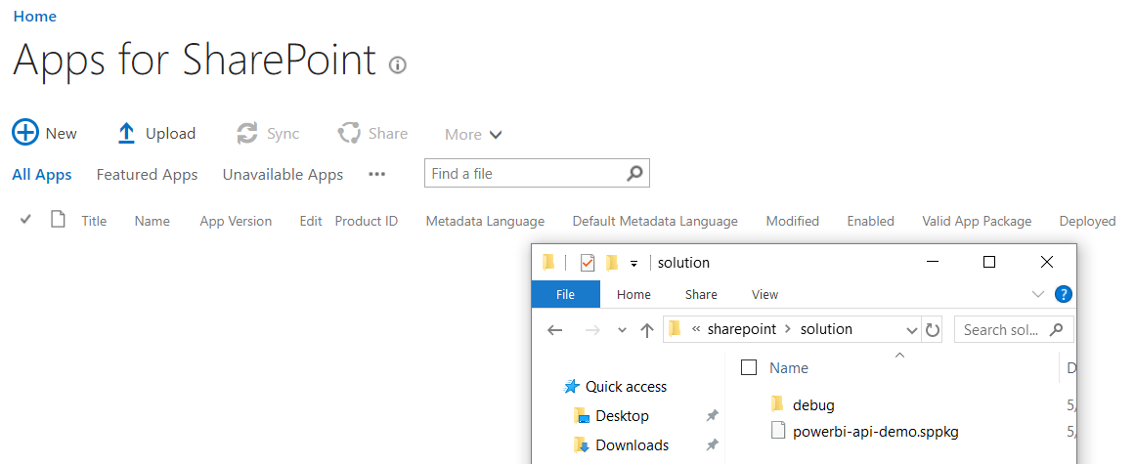
Deploy the Web Part to the App Gallery

Slide 49
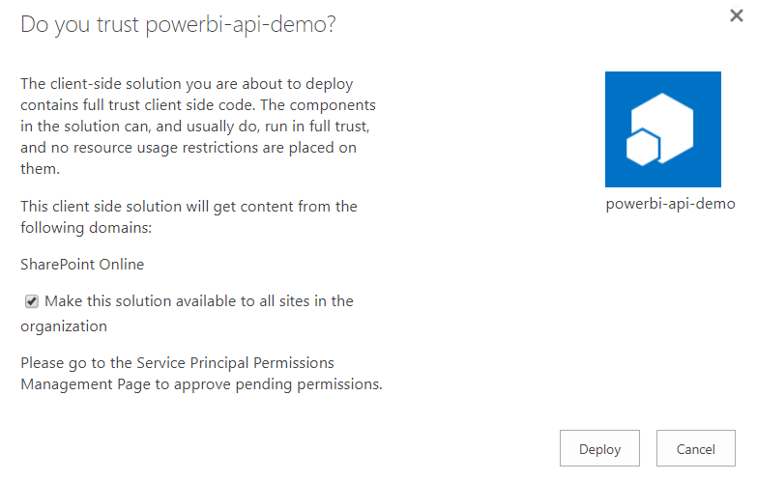
Configuring Trust

Slide 50
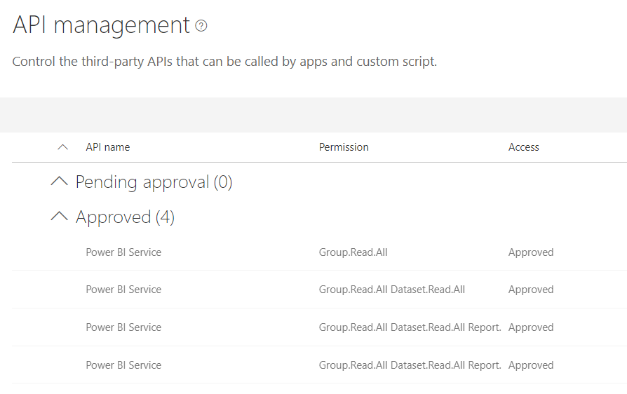
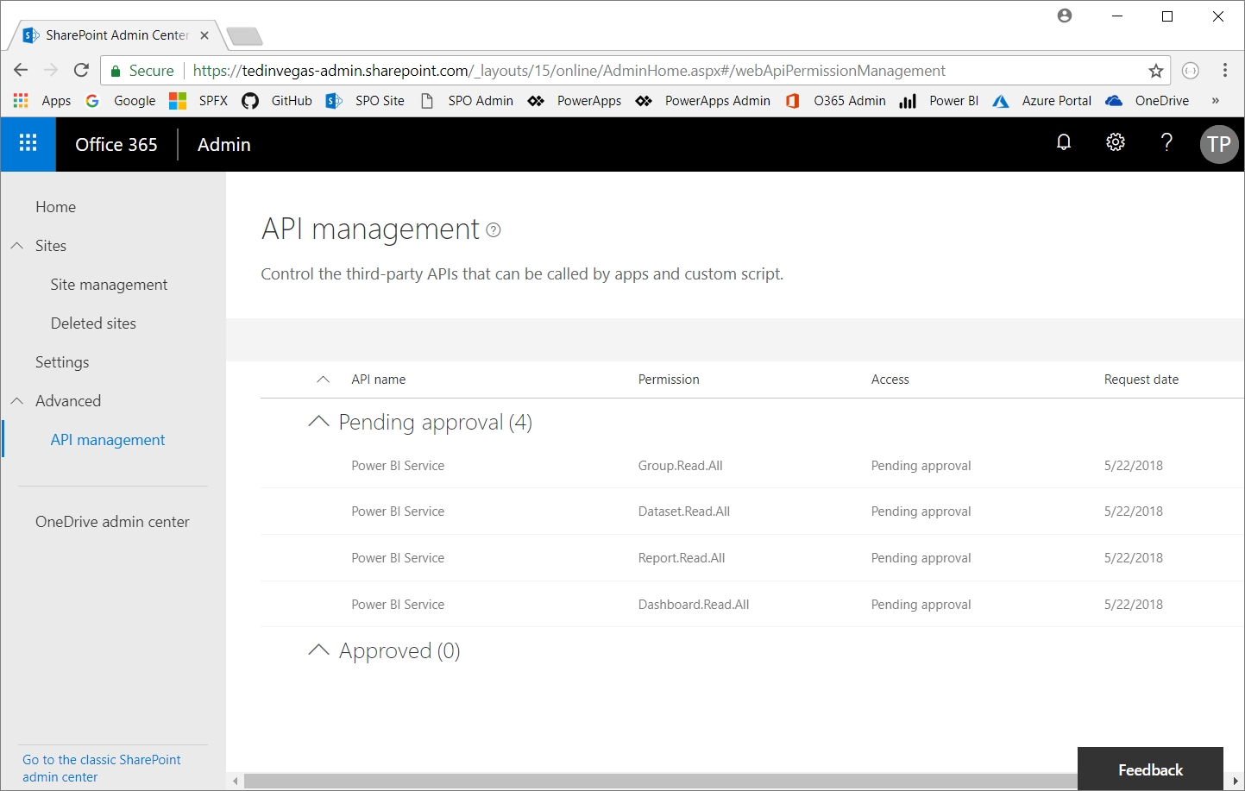
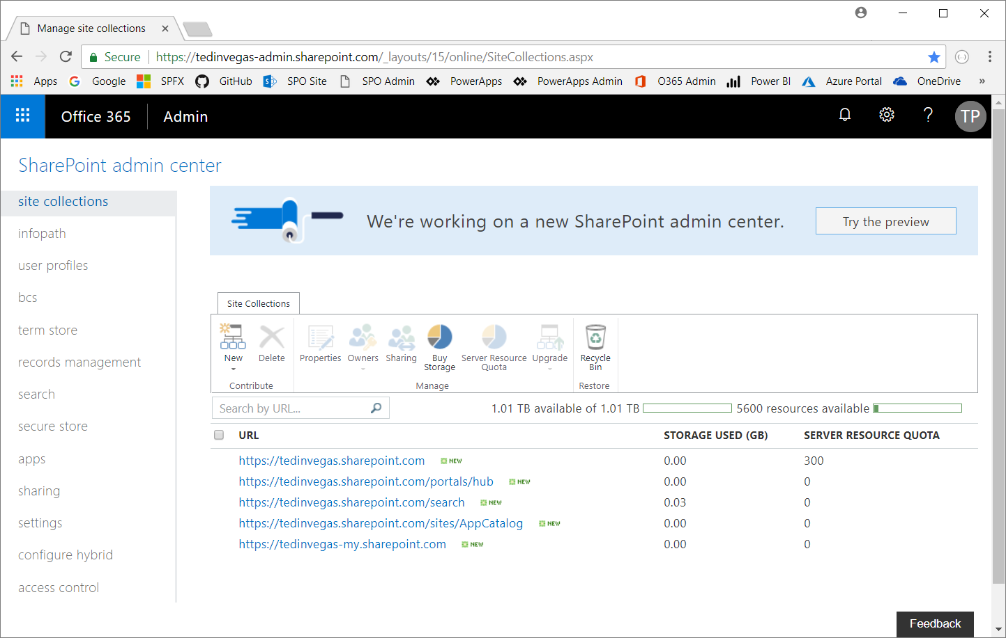
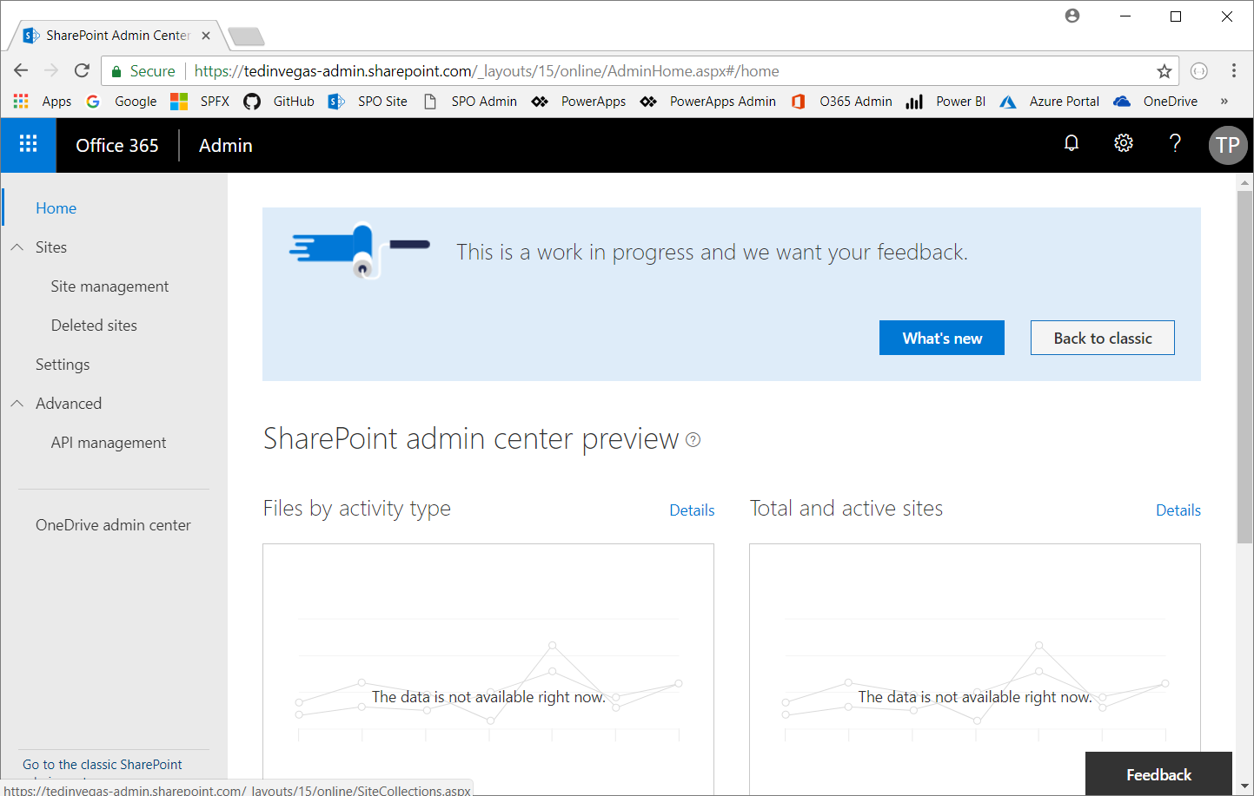
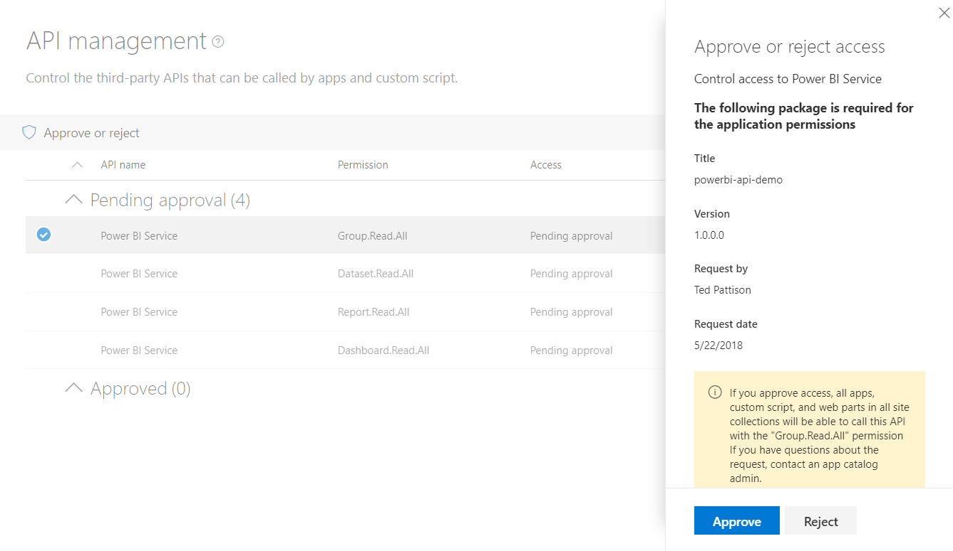
Granting Web API Permissions

Slide 51
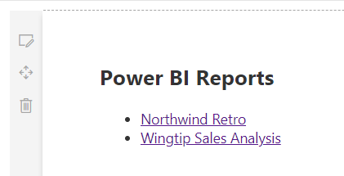
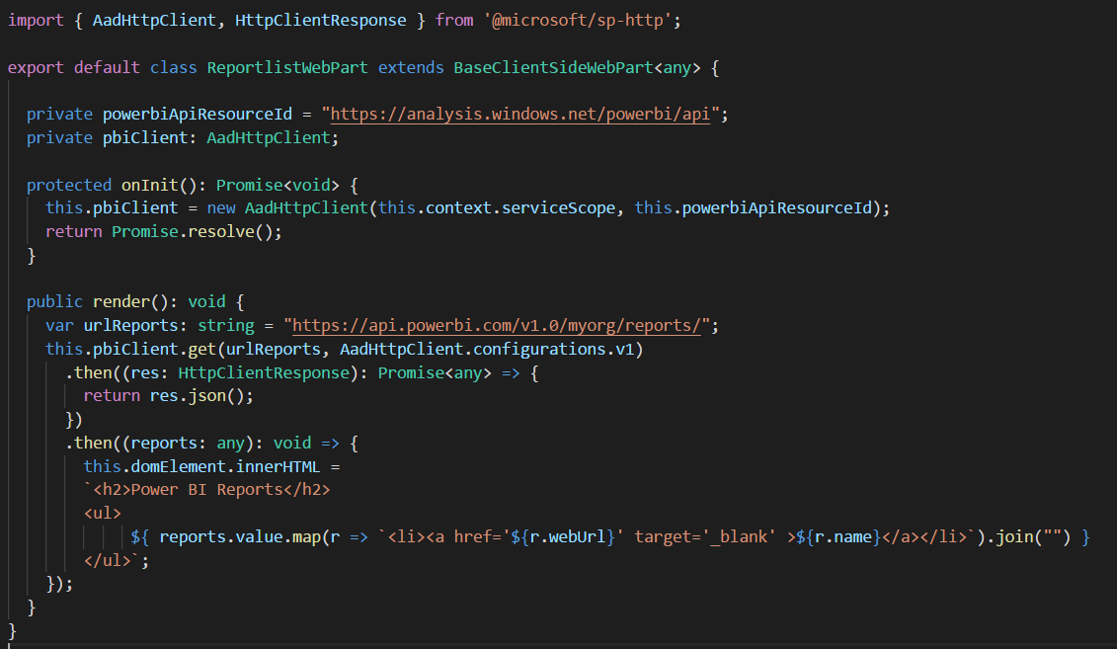
Calling Power BI API with AadHttpClient

Slide 52
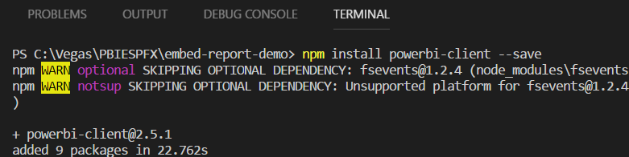


Installing the Power BI JavaScript API
npm install powerbi-client –save-dev

Slide 53


Slide 54
Summary
Power BI Embedding Fundamentals
App Workspaces and Dedicated Capacities
Programming with Power BI Service API
Embedding with Power BI JavaScript API
Calling the Power BI Service using AadHttpClient

